Slide 1

CP5046 – ICT Project 1: Analysis and Design
Project LAUNCH Presentation
Presenters: Karim Ashwath Vimal

Slide 2

Agenda
Project Team
User and Background
Intellectual Property
Solution
Potential and Competitive Advantage
Tools Required
Project Management
Risks
Conclusion

Slide 3
Project Team
Karim(12749720)
Vimal Adithann (12741594)
Aswath Baskaran (12686276)

Slide 4
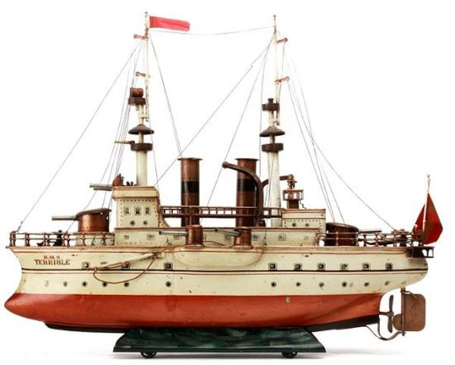



User and Background
OUR USER
~ 25 Customers

Slide 5
Solution
E-Commerce Website
Allows collectors to buy and sell via website with eBay being transparent
Free user and save time

Slide 6

Intellectual Property
Agree to eBay’s T&C
Follow security guidelines

Slide 7
Potential & competitive advantage
Can be expanded to include Yahoo and Amazon APIs
Useful for small startups
Highly customizable

Slide 8
Tools
Project Management
Scope
Schedule
Software Development Lifecycle
Development model
Gather and Analysis Requirements
Database and Object Design
Diagrams
Documentation

Slide 9
Tools
Hardware
Web Hosting
Database Hosting
Laptops
Software
Development Software
Skills
Interview Skills
Documentation Skills
Technical Skills

Slide 10
Project Management
Project Initiation – Week 3
Requirement Analysis – Week 4-5
Planning – Week 6-7
Design – Week 7-9
Documentation - Ongoing
Prototyping – Week 10-11
Presentation – Week 12

Slide 11
Risks
Risk | P | I | Mitigation Plan
Change to eBay APIs | L | H | Monitor eBay API news Change API before depreciation
User not satisfied with prototype | M | M | Continuous communication with user
Unable to translate user need into deliverable | L | H | Familiarization with technology Identify domain experts to consult

Slide 12
Conclusion
Saves time for user
Business process automation
Increase customer base
Potential to apply project to other start-ups
Different from regular e-commerce websites

Slide 13
Q & A

